Slide 1

PowerShell Performance & Technique Tweaks
The good, the bad and the ugly

Slide 2


about_Speaker
Get-SpeakerProfile –alias ‘HCRitter’
Name: Christian Ritter
Work: System Engineer @CANCOM
Private: Blog-Author, Husband, Father and PowerShell-Nerd
Get-Intouch

Slide 3
Get-SmartQuote
“If you are the smartest person in the room, then you are in the wrong room.”

Slide 4
Get-Agenda
[Technique]: Switch Command Gems
[Performance]: File-Reading
[Technique]: Splatting
[Technique]: Trapping
[Performance]: Sort-Unique
[Technique]: Smart-Aliassing
[Technique]: Parameter Validate Set
[Performance]: Querying – where in the world

Slide 5
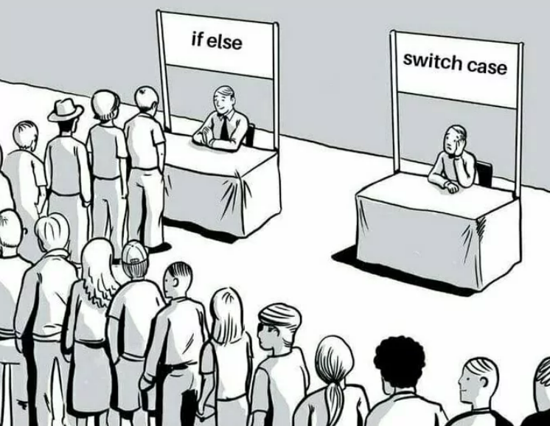
Get-Topic
Switch Command Gems

Slide 6
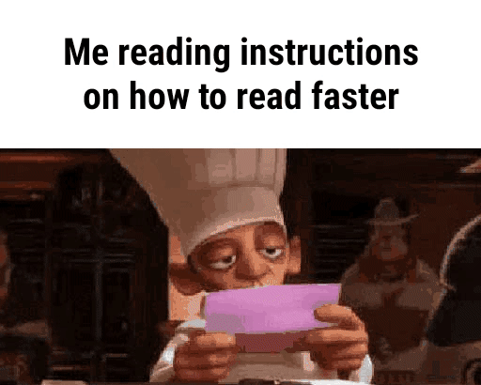
Get-Topic
File-Reading

Slide 7
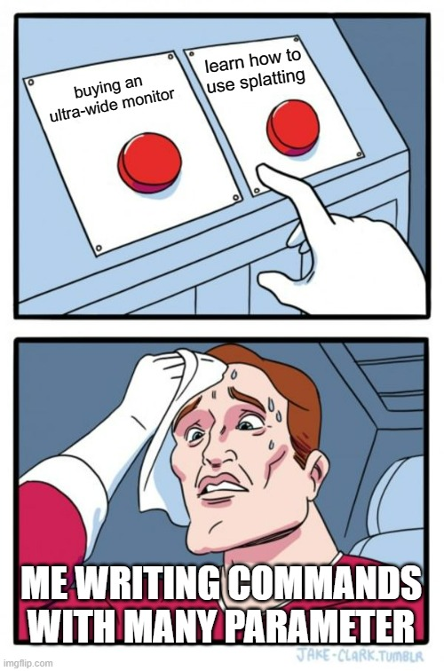
Get-Topic
Splatting

Slide 8

Get-Topic
Trapping

Slide 9
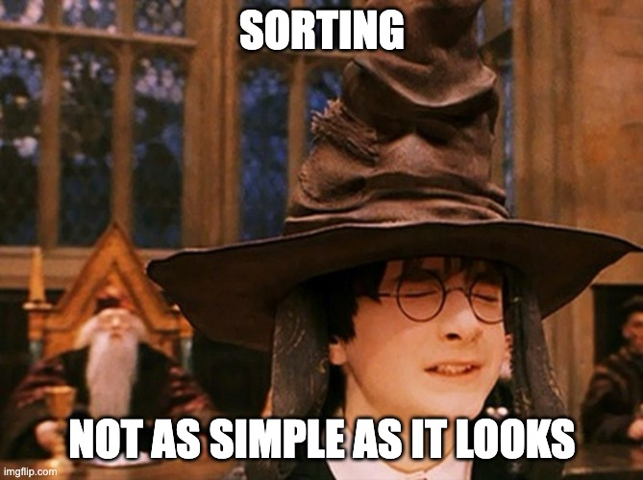
Get-Topic
Sort-Unique

Slide 10
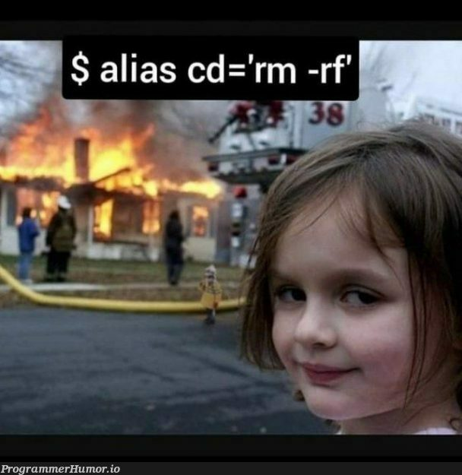
Get-Topic
Smart-Aliassing

Slide 11
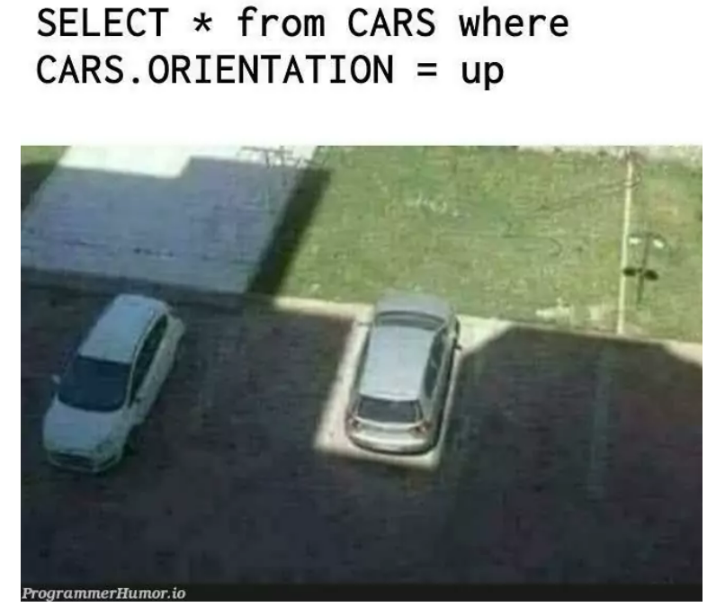
Get-Topic
Querying – Where in the world

Slide 12
Invoke-EndOfSession
Thank you for your Attention

